Slide 1
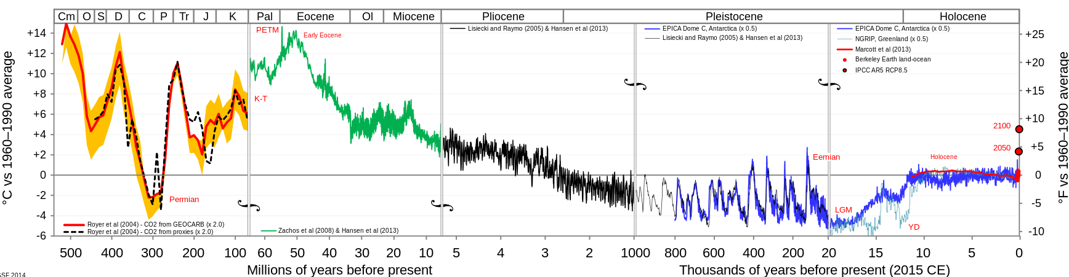
55 million years ago, Hothouse Earth
Past Present
Hothouse Earth
Icehouse Earth

Slide 2
Then, collision of India with Asia
Past Present
Hothouse Earth
Icehouse Earth
Collision video

Slide 3
Ice sheets formed and sea level dropped immensely
Greenland ice sheet forms
Past Present
Hothouse Earth
Icehouse Earth
Permanent ice in East Antarctic forms
65 meter drop in sea level
Another 110 meters drop during “ice ages”

Slide 4
Now (last few million years) we’re in a time if glacial-interglacial cycling
Past Present
Hothouse Earth
Icehouse Earth
Glacial-interglacial cycling

Slide 5
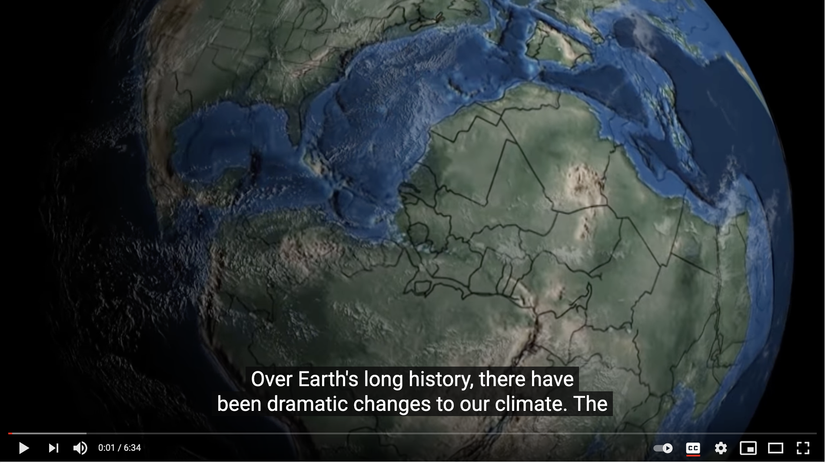
Timing of the cycling is controlled by Earth’s wobbles (Milankovich theory)
Merrill video on Milankovich

Slide 6
Most of each cycle is in the Glacial state
“Tacoma” buried under a couple of kilometers of ice
Wild swings in temperature
Low CO₂
Lots more arable land
More stable
Higher CO₂
Less ice
Lots of ice
Interglacial conditions
10,000 years
Glacial conditions
90,000 years

Slide 7
The most recent cycle: into the Holocene
70,000 years ago:
Climate-altering Toba supervolcano reduces human population to a few thousand
10,000 years ago: Agriculture, invented, cities arise
15,000 years ago: People cross into N. America
Now:
Due to go back to glacial conditions!
“Holocene”
10,000 years
Glacial conditions
90,000 years

Slide 8
Anthropocene: Like an extended Holocene
Anthropogenic GHG emissions have prevented our scheduled return to glacial conditions
Next alignment of Earth’s orbital wobbling that will open the door to interglacial conditions is 50,000 years from now!
“Anthropocene”
50,000 years
Glacial conditions
90,000 years

Slide 9
Climate amplification in the Pleistocene
Past Present
Hothouse Earth
Icehouse Earth
Glacial-interglacial cycling

Slide 10
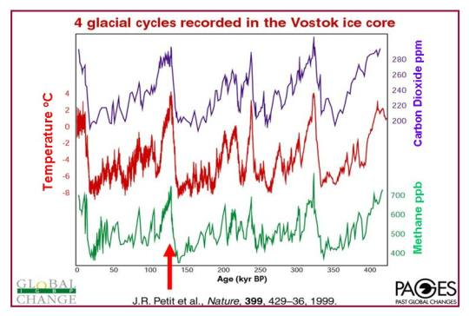
Climate amplification in the Pleistocene
Present Past
The fact that temperature, CO₂, and CH₄ are in very tight correlation suggests a positive feedback loop, like power steering in an automobile.
Over the last few million years, Milankovich wobbling is driving.
Now, human emissions are driving.

Slide 11
Questions for climate modelers
Present Past
Which kinda leads us to two fundamental questions:
Do we have the amplification (feedback) right?
Mechanism
Parameterization
Implementation (algorithm)
What exactly are we trying to represent?

Slide 12
Questions for climate modelers
Present Past
Which kinda leads us to two fundamental questions:
Do we have the amplification (feedback) right?
Mechanism
Parameterization
Implementation (algorithm)
What exactly are we trying to represent?

Slide 13
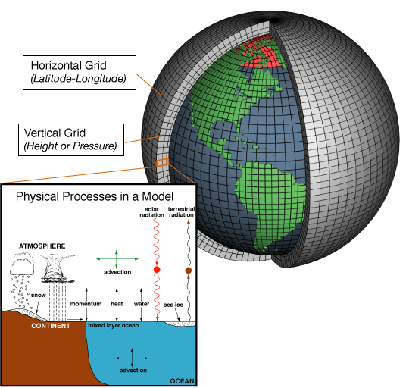
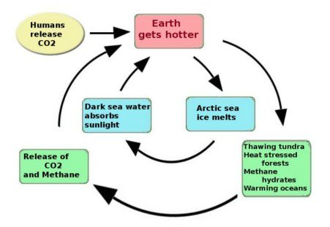
Do we have the right amplification mechanisms?

Slide 14
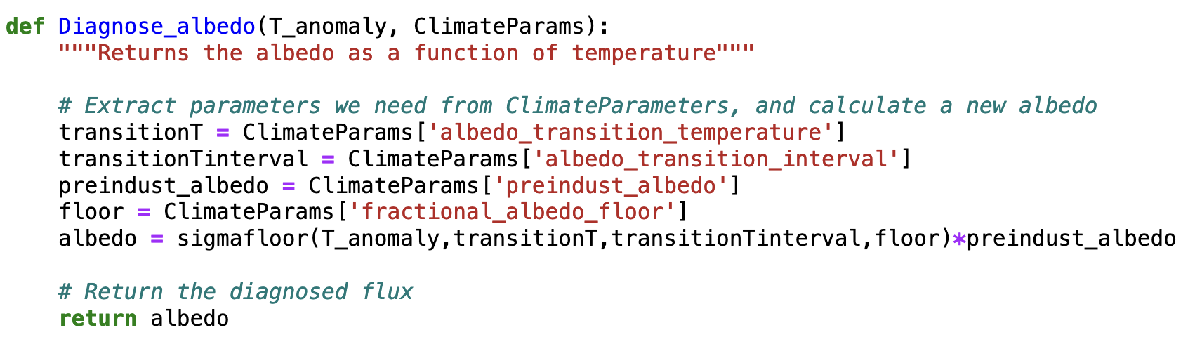
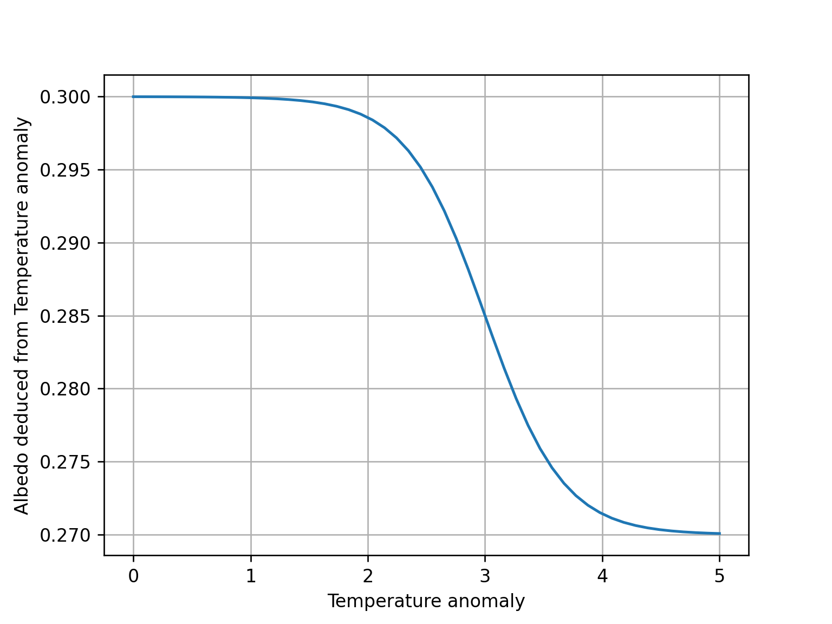
Diagnose_albedo
T_anomaly =>
albedo reduction
Preindustrial albedo is 0.3
Transition temperature:
½ -complete when T_anomaly is +3ºC
Transition Interval: about 1ºC to go from 80% to 20%
Floor: bottoms out at 0.27

Slide 15
Diagnose_albedo
T_anomaly =>
albedo reduction
Preindustrial albedo is 0.3
Transition temperature:
½ -complete when T_anomaly is +3ºC
Transition Interval: about 1ºC to go from 80% to 20%
In 2005, the CERES Science Team reported Earth’s shortwave albedo had been steadily declining at a rate of 0.0006/year, a rate that would lower albedo to 0.27 by 2050 or so.
Floor: bottoms out at 0.27
earthobservatory.nasa.gov/images/5484/earths-albedo-in-decline

Slide 16
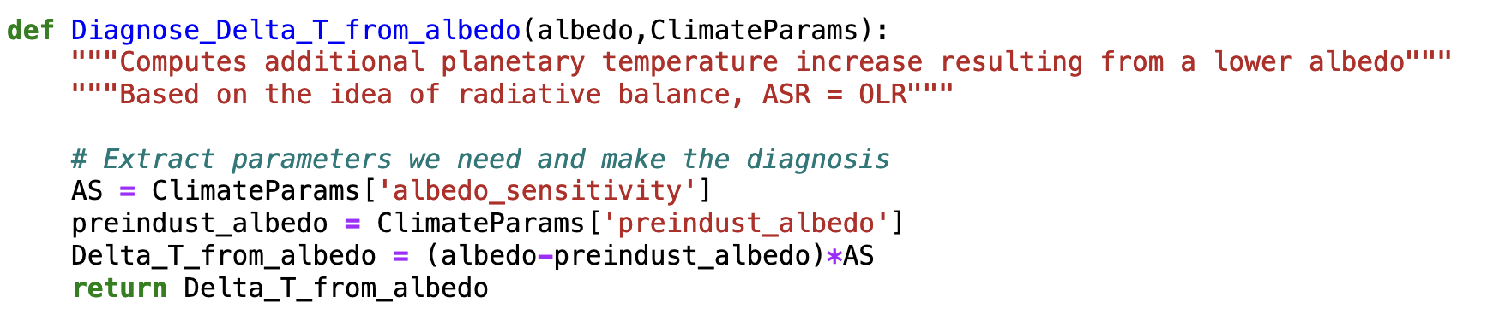
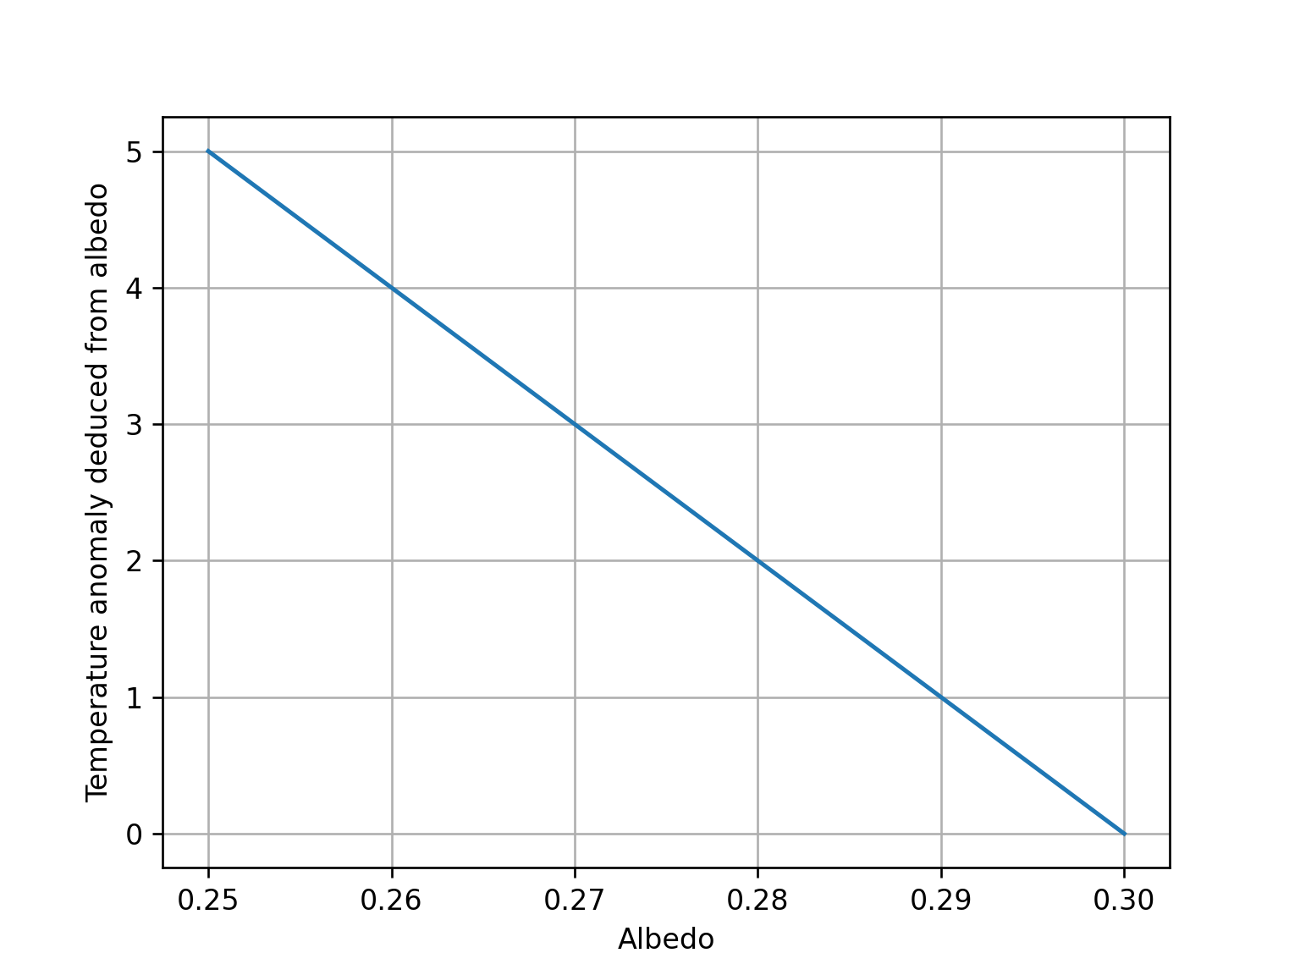
Diagnose_Delta_T_from_albedo
Albedo reduction => T_anomaly
Temperature is high when albedo is low
Our radiative balance modeling earlier said every reduction of 0.01 in albedo will lead to +1ºC.
Temperature is low when albedo is high

Slide 17
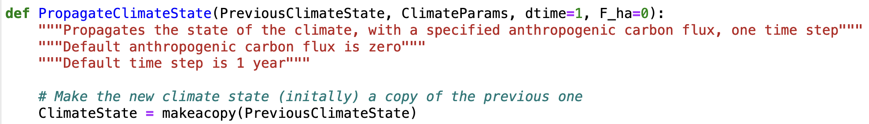
Taken together, this constitutes a feedback loop
As implemented in PropagateClimateState
...
...

Slide 18
Questions for us climate modelers
Present Past
Which kinda leads us to two fundamental questions:
Do we have the amplification (feedback) right?
Mechanism
Parameterization
Implementation (algorithm)
What exactly are we trying to represent?

Slide 19
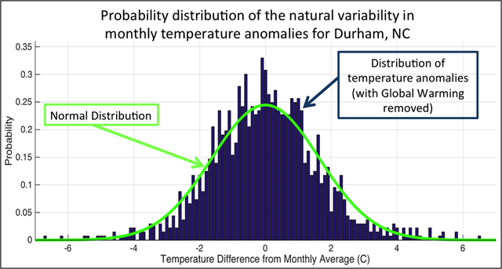
The problem of temporal variability
We’ve seen a lot of geographical variability in the observational record (EdGCM). How about temporal variability at a given location?

